Slide 1

Objectives
In this session, you will learn to:
  Explore your computer
  Manipulate folders and files
  Change the display
  Use accessories
Notes:
Share the session objectives with the students.

Slide 2
Exploring Your Computer
Microsoft Windows Explorer is a program that enables you to view and manage the files and folders on your computer.
To open the Windows Explorer, select Start→All Programs→Accessories→Windows Explorer.

Slide 3
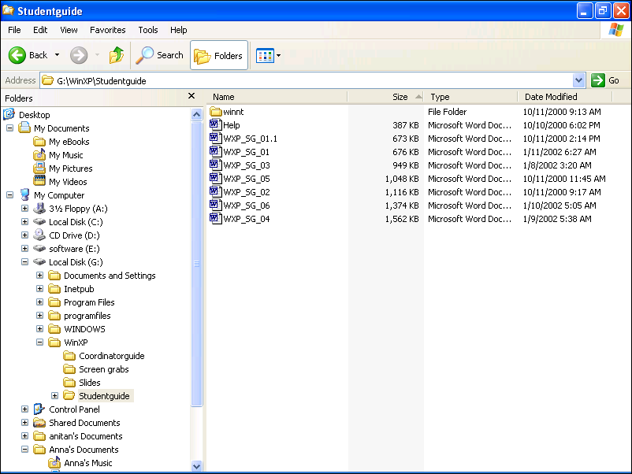
Exploring Your Computer (Contd.)
The following figure shows the Windows Explorer window.
Toolbar
Folders
Pane
Contents
Pane
Plus
Sign

Slide 4
Exploring Your Computer (Contd.)
A window consists of:
  Folders pane
  Contents pane
  Toolbar

Slide 5
Exploring Your Computer (Contd.)
Folders Pane:
  The Folders pane displays all the folders in a hierarchical structure.
  A plus sign (+) icon attached to a folder icon is an indication that the folder contains other levels of folders.
  Some of the main folders that appear in this pane are:
    My Documents
    Shared Documents
    My Network Places

Slide 6
Exploring Your Computer (Contd.)
Contents Pane:
  The Contents pane displays the files and sub folders contained in it.
  The view of the Contents pane can be modified by selecting one of the following options from the View menu:
    Thumbnails
    Tiles
    Icons
    List
    Details

Slide 7

Exploring Your Computer (Contd.)
Toolbar:
  The Toolbar of the Explorer window displays buttons which act as shortcuts to the menu items.
  The following figure displays a Toolbar.
Forward Button
Search Button
Back Button
View Button
Up Button
Folders Button

Slide 8
Exploring Your Computer (Contd.)
Toolbar (Contd.):
  The Toolbar contains the following buttons:
    Back
    Forward
    Up
    Search
    Folder
    Views

Slide 9
Managing Files and Folders
The common tasks that can be used on files and folders are:
  Make a new folder
  Create a new file
  Rename
  Copy
  Move
  Delete
Notes:
Tell the students that dimensions are components of data mart/ data warehouse. Dimensions will be discussed in details in Ch5.

Slide 10
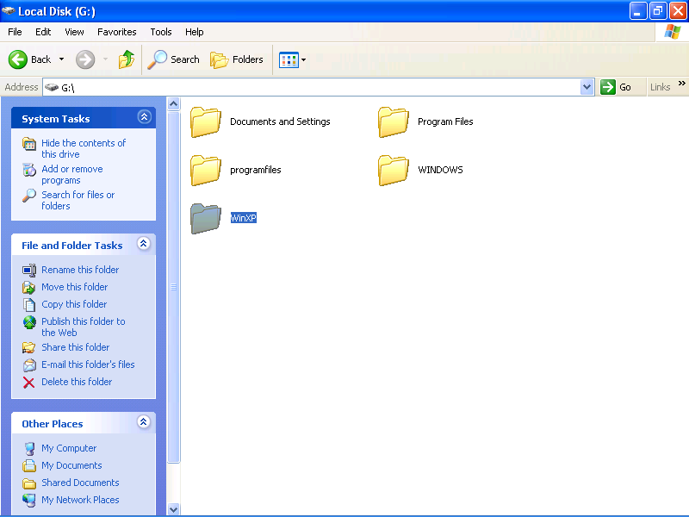
Managing Files and Folders (Contd.)
The tasks that can be performed on the file or folder are given under File and Folder Tasks, as displayed in the following figure.
File and Folder Tasks
Notes:
Tell the students that dimensions are components of data mart/ data warehouse. Dimensions will be discussed in details in Ch5.

Slide 11
Managing Files and Folders (Contd.)
Some tasks are specific to the file or folders that is opened.
Let us discuss the steps to perform some of the common tasks on files and folders.
Notes:
The following example can be given to explain the federated approach:
Consider a scenario where a manufacturing company called MakeProducts, Inc. is having several business processes and sister concerns. Each of the business processes and sister concerns have their own data warehouses. Now, consider a situation where the senior management of the company decides to develop a company- wide data warehouse encompassing the business processes and sister concerns. In such a case, the company can select the federated approach, where the existing data warehouses are integrated to form a company-wide data warehouse.

Slide 12
Managing Files and Folders (Contd.)
Creating a Folder:
  The steps to create a new folder are:
    Select the folder in which you want to create the new folder.
    Select the Make a new folder hyperlink from the File and Folder Tasks list.
    Type the name of the folder and press Enter.
Notes:
The following example can be given to explain the federated approach:
Consider a scenario where a manufacturing company called MakeProducts, Inc. is having several business processes and sister concerns. Each of the business processes and sister concerns have their own data warehouses. Now, consider a situation where the senior management of the company decides to develop a company- wide data warehouse encompassing the business processes and sister concerns. In such a case, the company can select the federated approach, where the existing data warehouses are integrated to form a company-wide data warehouse.

Slide 13
Managing Files and Folders (Contd.)
Creating a File:
  The steps to create a file in a folder are:
    Click the File menu in Windows Explorer.
    Select the New option.
    Select the type of file from the New submenu.
Notes:
The following example can be given to explain the federated approach:
Consider a scenario where a manufacturing company called MakeProducts, Inc. is having several business processes and sister concerns. Each of the business processes and sister concerns have their own data warehouses. Now, consider a situation where the senior management of the company decides to develop a company- wide data warehouse encompassing the business processes and sister concerns. In such a case, the company can select the federated approach, where the existing data warehouses are integrated to form a company-wide data warehouse.

Slide 14
Managing Files and Folders (Contd.)
Renaming Files and Folders:
  You can change the name of a file and folder with the following steps:
    Click the file or folder that you want to rename.
    Click the Rename this file/Rename this folder hyperlink in the File and Folder Tasks list in the left pane. In other operating systems, click the right mouse button and select the Rename option. A cursor will appear in the file/folder name that will enable you to edit the name.
    Type the new name.
    Press Enter.
Notes:
The following example can be given to explain the federated approach:
Consider a scenario where a manufacturing company called MakeProducts, Inc. is having several business processes and sister concerns. Each of the business processes and sister concerns have their own data warehouses. Now, consider a situation where the senior management of the company decides to develop a company- wide data warehouse encompassing the business processes and sister concerns. In such a case, the company can select the federated approach, where the existing data warehouses are integrated to form a company-wide data warehouse.

Slide 15
Managing Files and Folders (Contd.)
Copying Files and Folders:
  To copy a file or folder, perform the following steps:
    Click the file or folder that you want to copy.
    Click the Copy this file or Copy this folder hyperlink under File and Folder Tasks in the left pane of the window. The Copy Items dialog box will be displayed.
    Select a folder from the list and click the Copy button and the file or folder will be copied to that folder.
Notes:
The following example can be given to explain the federated approach:
Consider a scenario where a manufacturing company called MakeProducts, Inc. is having several business processes and sister concerns. Each of the business processes and sister concerns have their own data warehouses. Now, consider a situation where the senior management of the company decides to develop a company- wide data warehouse encompassing the business processes and sister concerns. In such a case, the company can select the federated approach, where the existing data warehouses are integrated to form a company-wide data warehouse.

Slide 16
Managing Files and Folders (Contd.)
Moving Files and Folders:
  To move a file or folder, perform the following steps:
    Click the file or folder that you want to move.
    Click the Move this file or Move this folder hyperlink under File and Folder Tasks in the left pane of the window. The Move Items dialog box will be displayed.
    Select a folder from the list and click the Move button and the file or folder will be moved to that folder.
Notes:
The following example can be given to explain the federated approach:
Consider a scenario where a manufacturing company called MakeProducts, Inc. is having several business processes and sister concerns. Each of the business processes and sister concerns have their own data warehouses. Now, consider a situation where the senior management of the company decides to develop a company- wide data warehouse encompassing the business processes and sister concerns. In such a case, the company can select the federated approach, where the existing data warehouses are integrated to form a company-wide data warehouse.

Slide 17
Managing Files and Folders (Contd.)
Deleting Files and Folders:
  To delete a file or folder, perform the following steps:
    Click the file or folder that you want to delete.
    Click the Delete this file or Delete this folder hyperlink under File and Folder Tasks in the left pane of the window. The Delete Items dialog box will be displayed.
    Select a folder from the list and click the Delete button and the file or folder will be deleted.
  The deleted files and folders are moved to the Recycle Bin folder. You can restore or permanently delete the files using menu options from the Recycle Bin folder.
Notes:
The following example can be given to explain the federated approach:
Consider a scenario where a manufacturing company called MakeProducts, Inc. is having several business processes and sister concerns. Each of the business processes and sister concerns have their own data warehouses. Now, consider a situation where the senior management of the company decides to develop a company- wide data warehouse encompassing the business processes and sister concerns. In such a case, the company can select the federated approach, where the existing data warehouses are integrated to form a company-wide data warehouse.

Slide 18
Changing the Display
The Display Properties option enables you to apply a background to the desktop screen, change the colors of the desktop screen, and apply a screen saver.
To open the Display Properties dialog box, perform the following steps:
  Click the right mouse button on the blank area of the Desktop screen. A menu is displayed.
  Select the Properties option from the menu. The Display Properties dialog box is displayed.
If the computer is on and idle for some time, some attractive pictures or some special effects are displayed on the screen automatically. This is called a Screen Saver.

Slide 19
Changing the Display (Contd.)
The various tabs displayed under Display Properties are:
  Themes
  Desktop
  Screen Saver
  Appearance
  Settings

Slide 20
Using Accessories
An accessory is a powerful and fully integrated set of tools for Windows operating system.
To open the Accessories option in Windows Explorer, select Start→All Programs→Accessories.
The various options included in accessories are:
  Calculator
  Notepad
  Paint
Let us discuss each of these options.

Slide 21
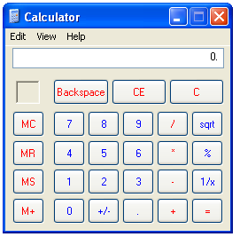
Using Accessories (Contd.)
Calculator:
  The Calculator accessory allows you to perform simple mathematical as well as complex statistical and scientific calculations. The following figure displays a calculator.

Slide 22
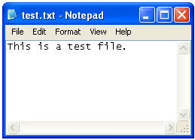
Using Accessories (Contd.)
Notepad:
  Notepad is used to write letters, short memos, resumes, and other documents. The following figure displays a notepad.
  Some of the features of Notepad are:
    Word wrap
    Copying and pasting text
    Finding text

Slide 23
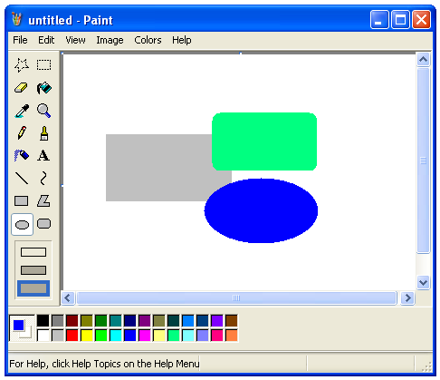
Using Accessories (Contd.)
Paint:
  Paint is another accessory that you can use to draw images or drawings. The following figure displays the Paint accessory.
Toolbox

Slide 24
Summary
In this lesson, you learned that:
  Microsoft Windows Explorer is a program that enables you to view and manage the files and folders on your computer.
  The Explorer window is divided into two panes:
    Folders Pane
    Contents Pane
  The Folders pane of the Explorer window shows all folders and files in a hierarchical structure.
  A plus sign icon attached to a directory is an indication that the directory or folder contains other folders or files.
  For each folder selected in the Folders pane, the Contents pane displays the files and sub folders contained in it.

Slide 25
Summary (Contd.)
  The view of the Contents pane can be modified by selecting different options from the View menu.
  The Toolbar of the Explorer window displays buttons which act as shortcuts to the menu items.
  Windows Explorer provides easy access to common tasks that can be performed on files and folders.
  The common tasks that can be used on files and folders are:
    Make a new folder
    Create a new file
    Rename
    Copy
    Move
    Delete

Slide 26
Summary (Contd.)
  The tasks that can be performed on the file or folder are given under File and Folder Tasks.
  You can select the Make a new folder hyperlink from the File and Folder Tasks list to create a new folder.
  You can select the New option from the File menu to create a new file in Windows Explorer.
  You can select the file or folder and click on the Rename this file/Rename this folder hyperlink in the File and Folder Tasks list in the left pane to rename a file or folder.
  You can copy a file by selecting the Copy this file or Copy this folder hyperlink under File and Folder Tasks in the left pane of the window.

Slide 27
Summary (Contd.)
  You can move a file by selecting the Move this file or Move this folder hyperlink under File and Folder Tasks in the left pane of the window.
  You can delete selected files or folders by clicking on the Delete this file or Delete this folder hyperlink under File and Folder Tasks.
  You can change the appearance of the Desktop screen using Display Properties dialog box.
  Themes enable you to change the desktop appearance, the look of icons, background, mouse pointers, screen saver, and have different sounds among other things.
  Desktop is applied to display a background or wallpaper to make it look more attractive.

Slide 28
Summary (Contd.)
  Screen saver is some attractive pictures or some special effects that are displayed on the screen automatically, if the computer is on and idle for some time.
  The Calculator accessory allows you to perform simple mathematical as well as complex statistical and scientific calculations.
  Notepad is used to write letters, short memos, resumes, and other documents.
  Paint is used to draw images.

